Slide 1
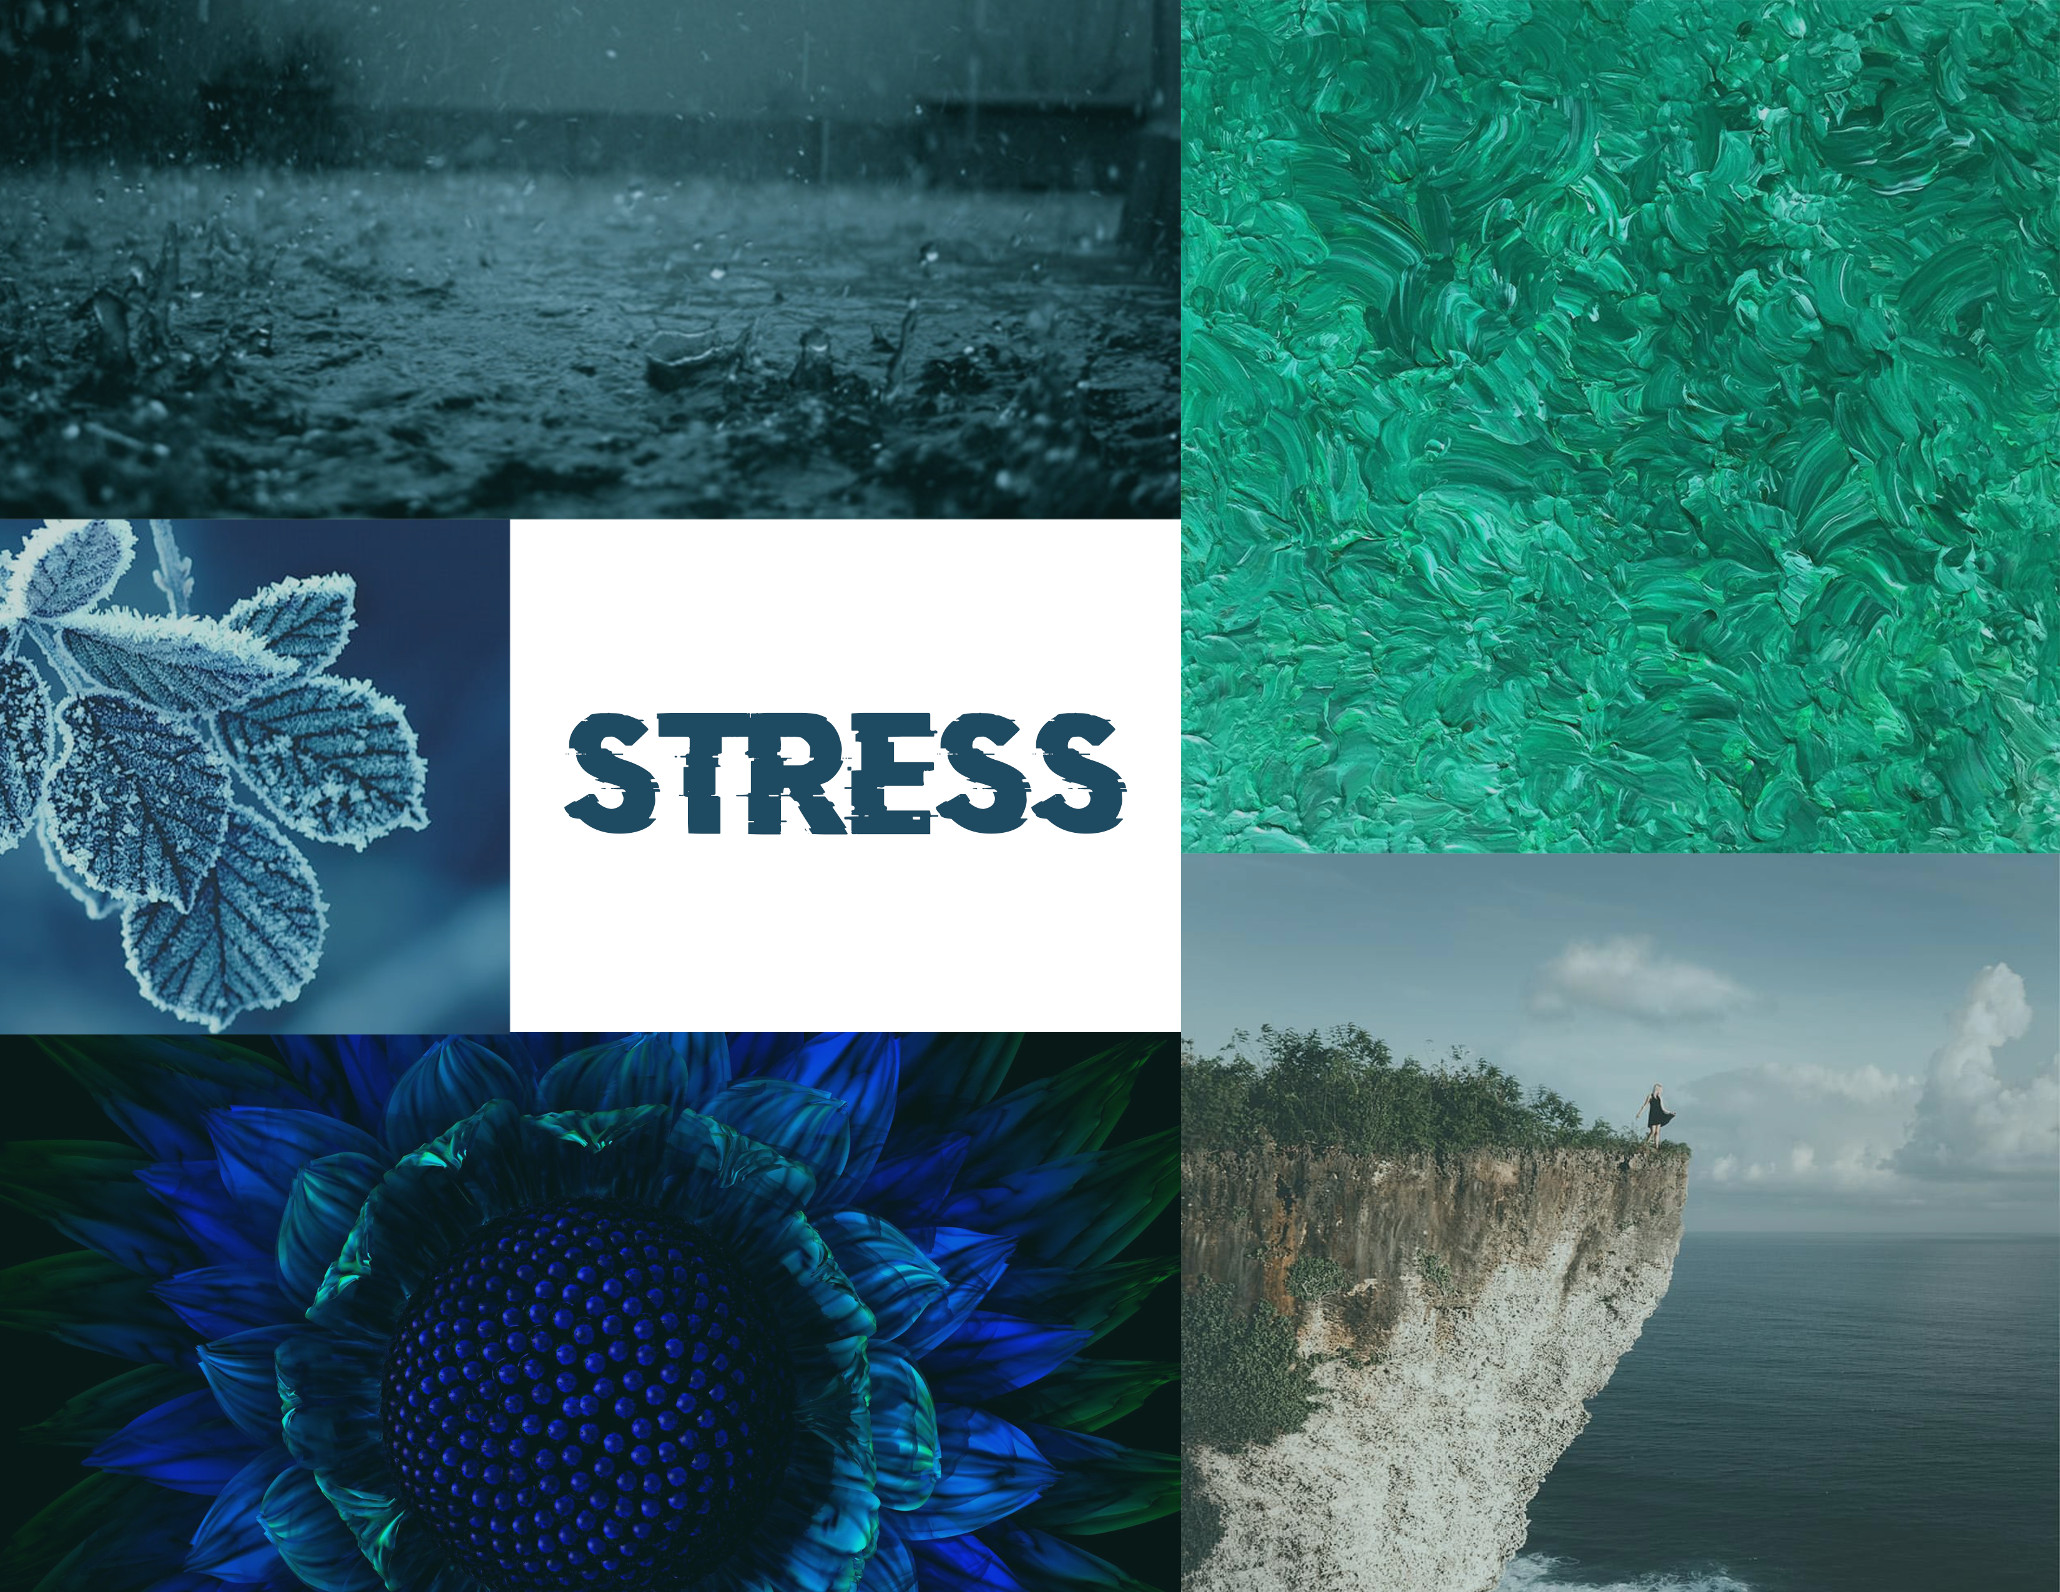
Mood Board
Description of your mood board based on the criteria you have chosen. What are the keywords? Any visual patterns you have observed? What are the key visual elements?
Kate Shan

Slide 2
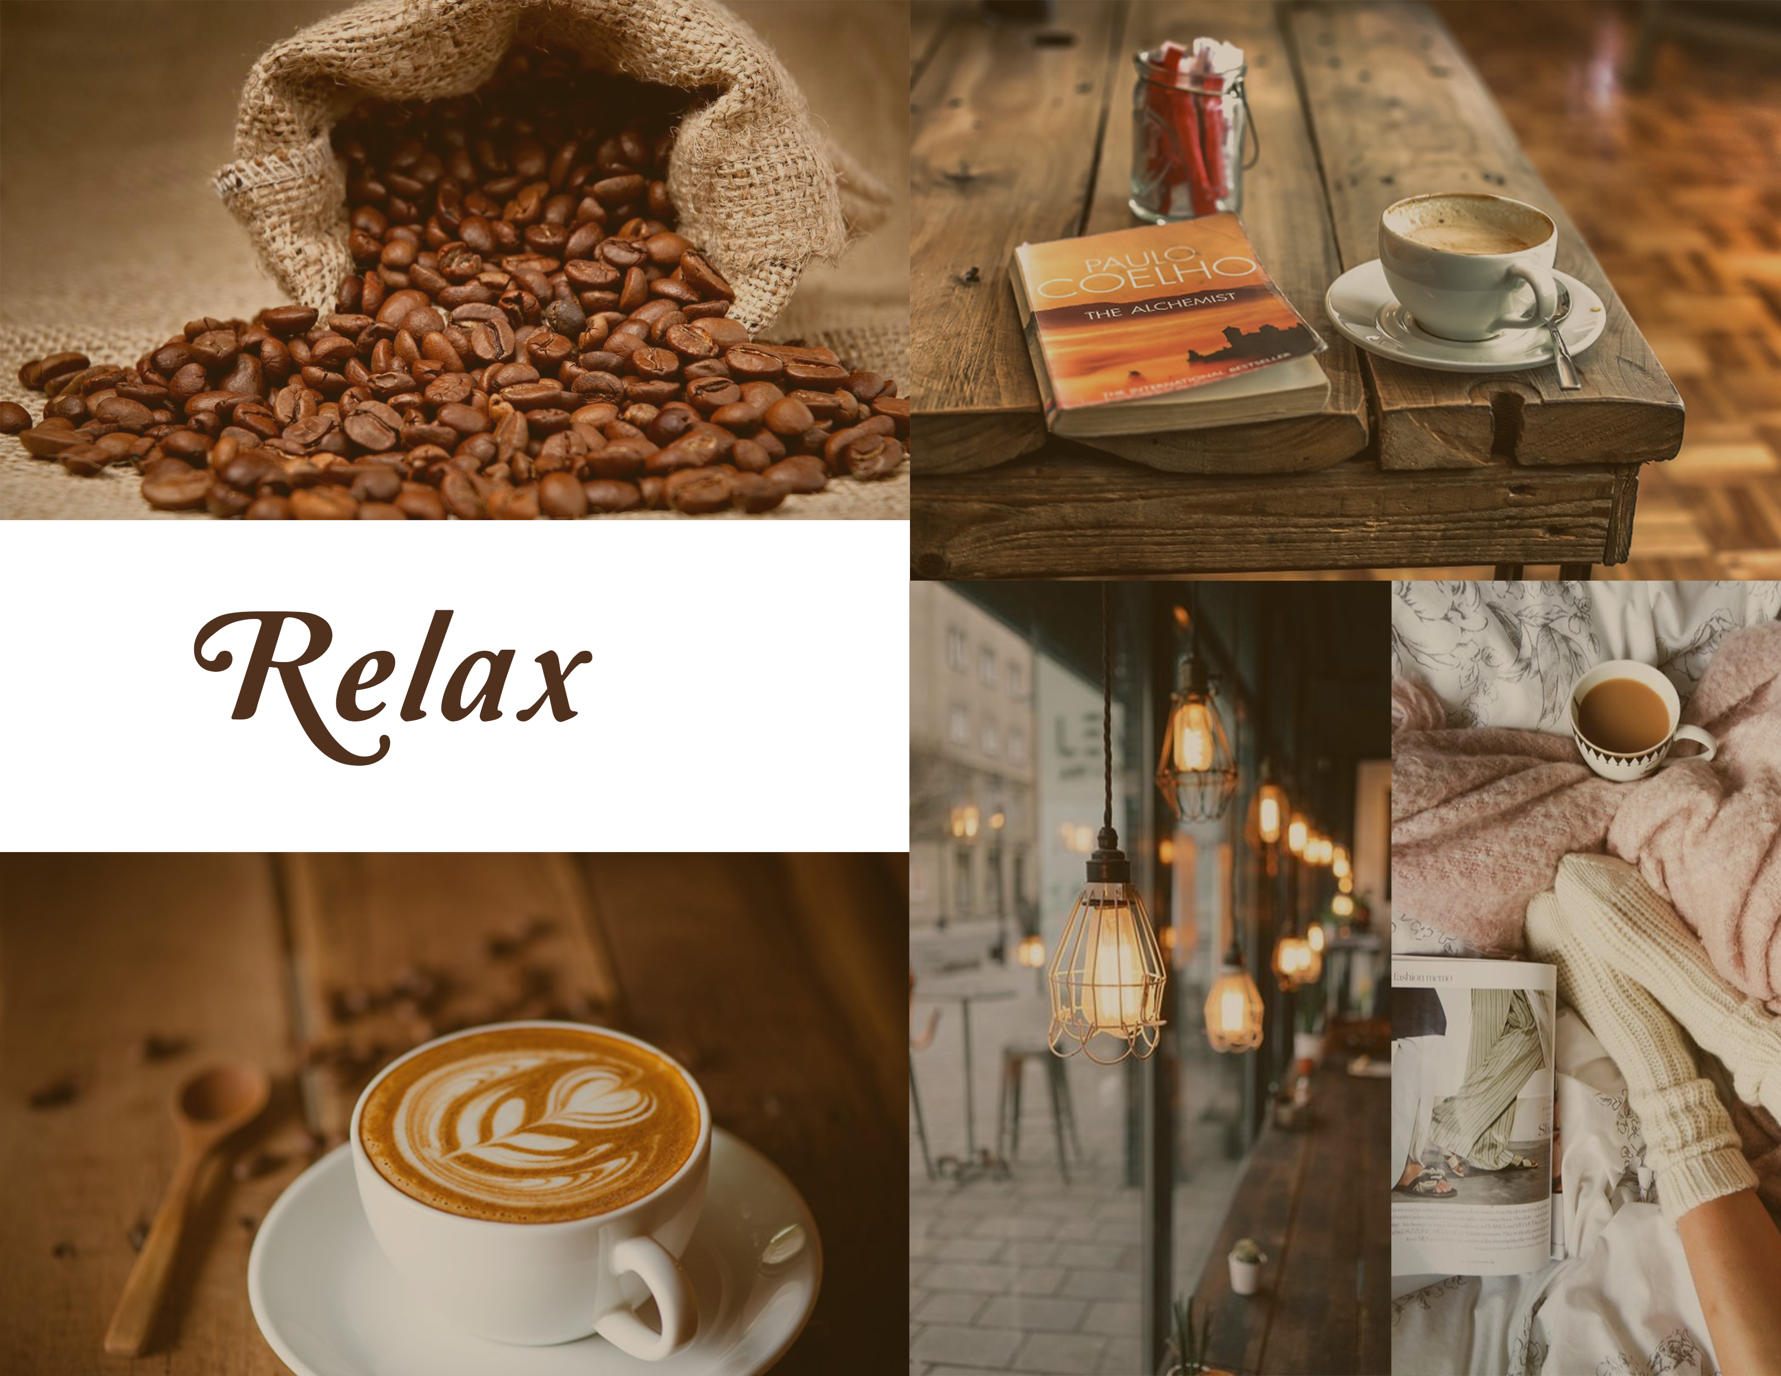
Mood Board
Description of your mood board based on the criteria you have chosen. What are the keywords? Any visual patterns you have observed? What are the key visual elements?
Kate Shan

Slide 3
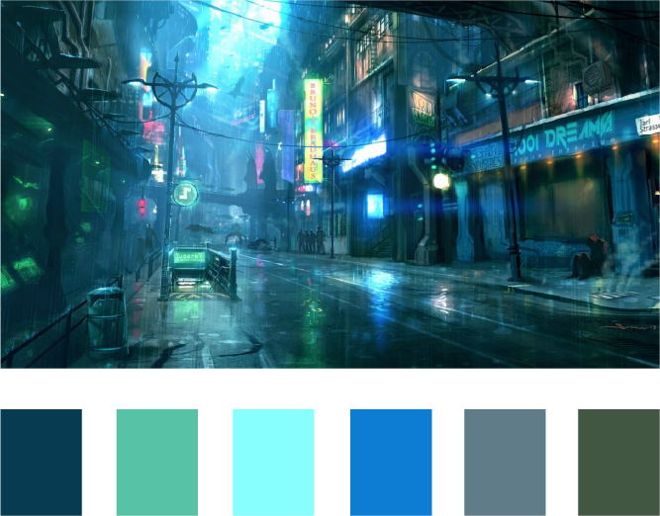
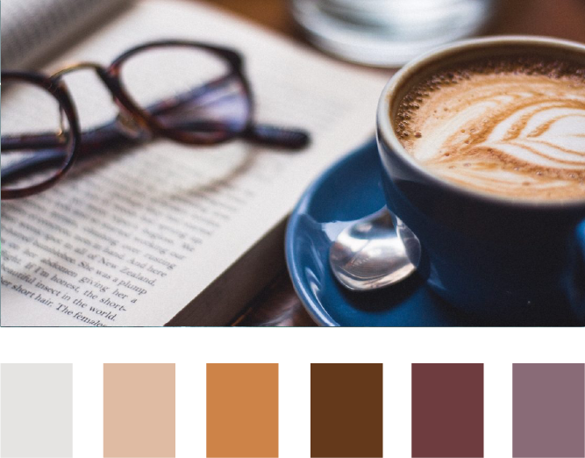
Color Palette
Screen 1: Stress Status
Screen 2: Relaxation
Kate Shan

Slide 4
Typography
Amperzand
This is Amperzand regular. This font is used in displaying the date. As a hand-drawn cat is used to display the stress of users, Amperzand is used to create a playful atmosphere though out the whole design.
Pairing type
Pairing type
Pairing type
Alpha Wood
This is Alpha Wood regular. This is used to create a stressful feeling but still maintain the hand-drawn topic for the whole design.
HeadLineA
This is HeadLineA regular. This is used to tell user to click on “Next” button. Using this font instead of Alpha wood is because I want to give user a more positive feeling and encourage them to click on “Next”.
Kate Shan

Slide 5
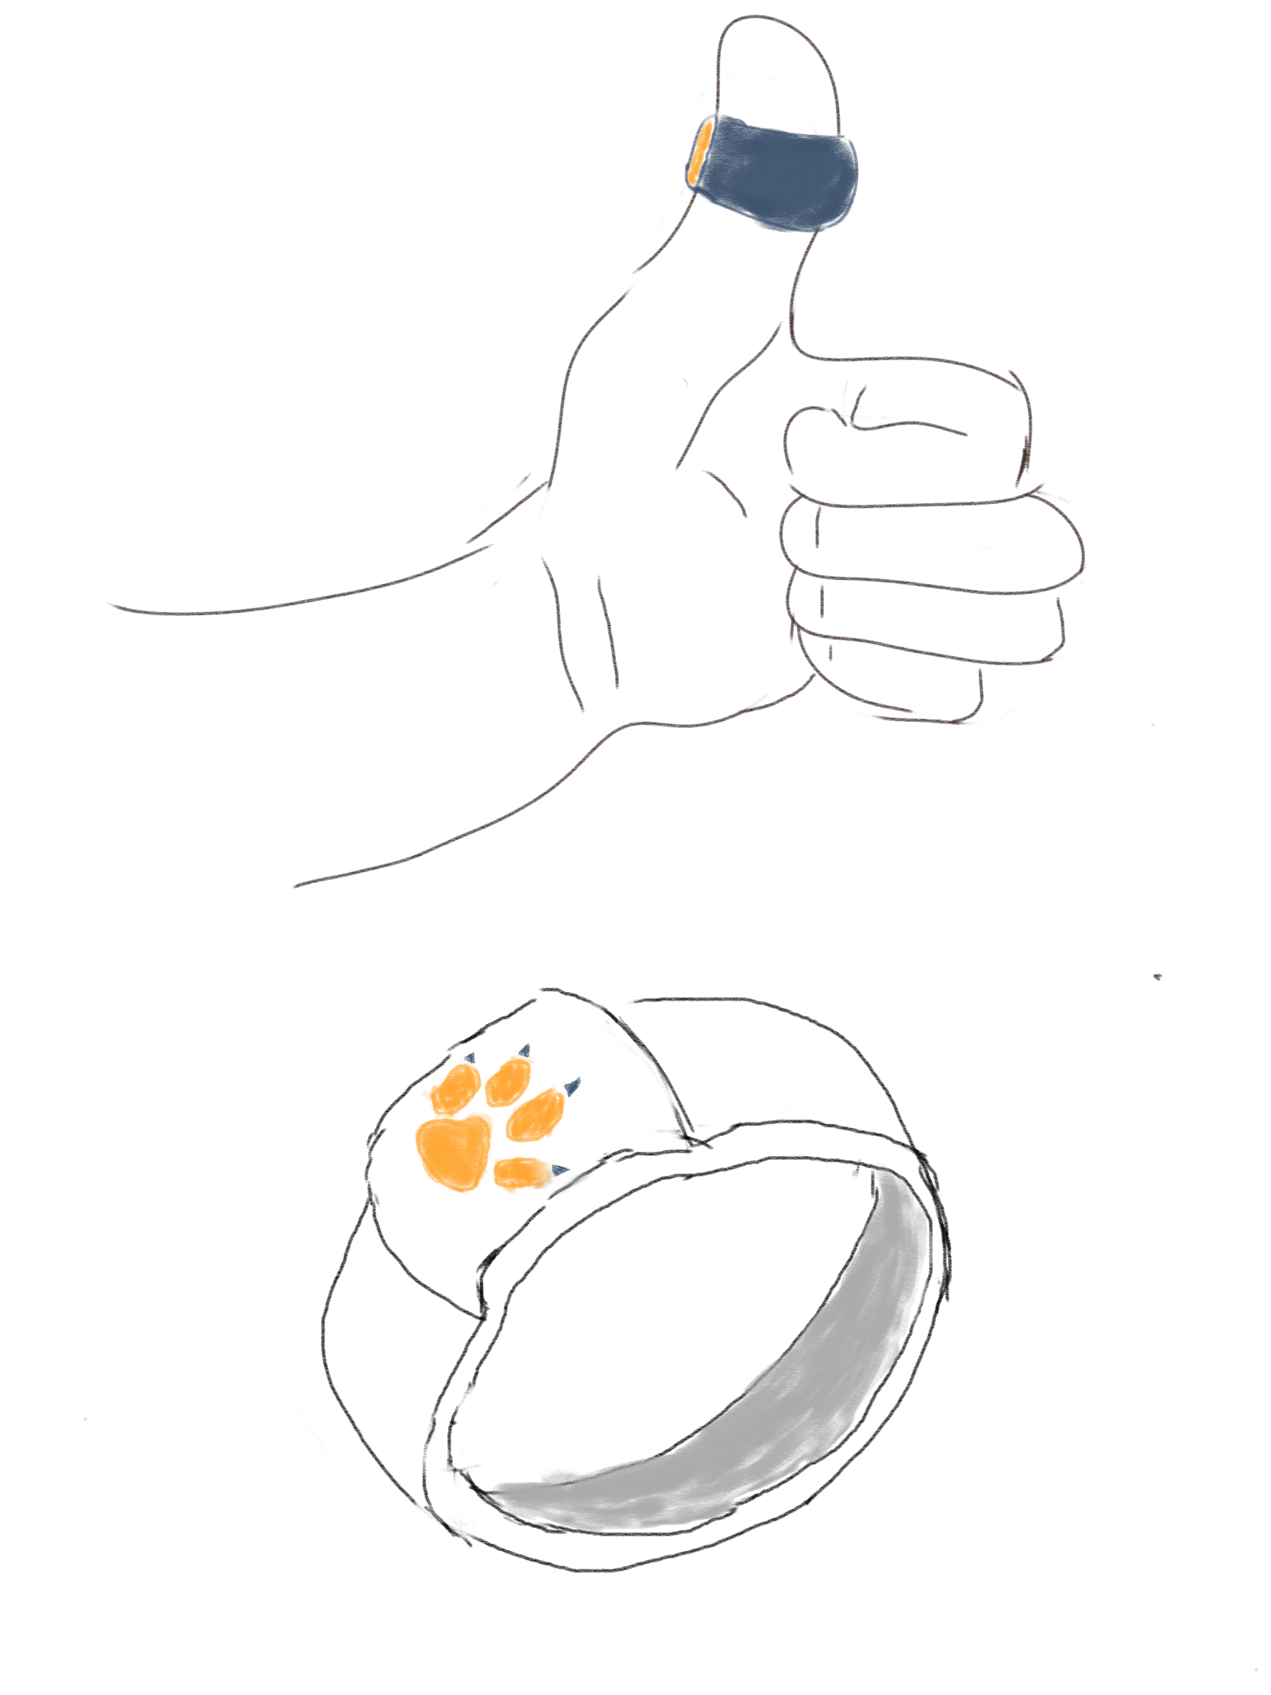
Wearable Sketches
Thumb ring
Displays warning when it senses stress from user!

Slide 6
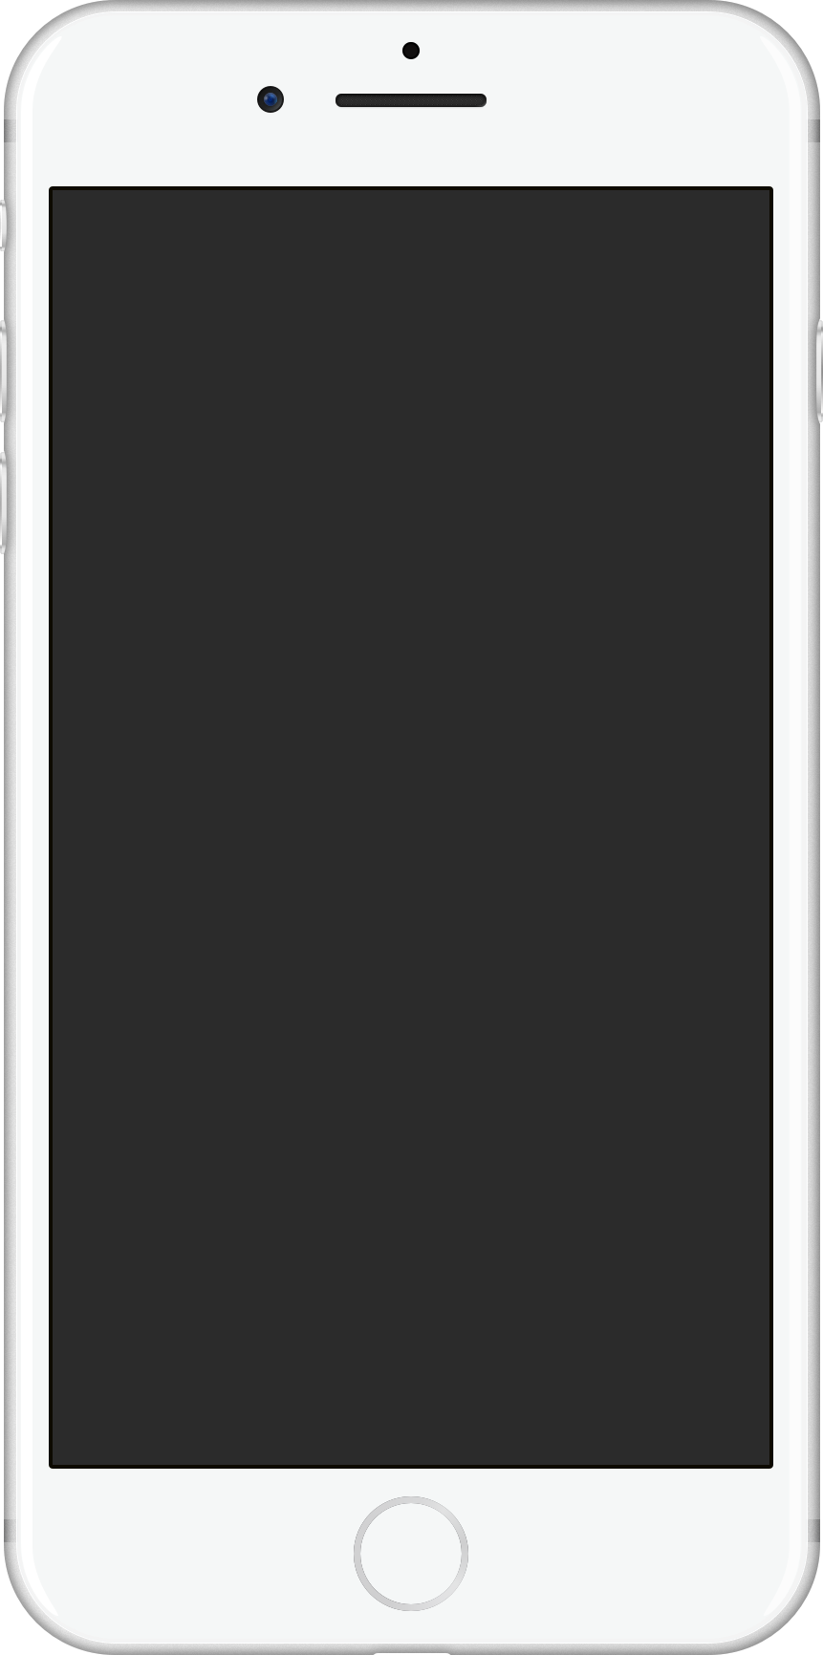

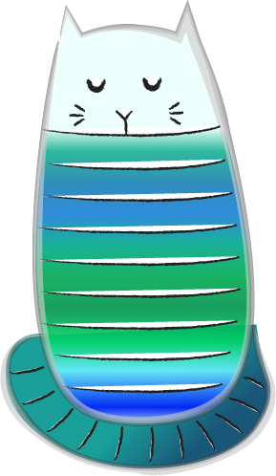
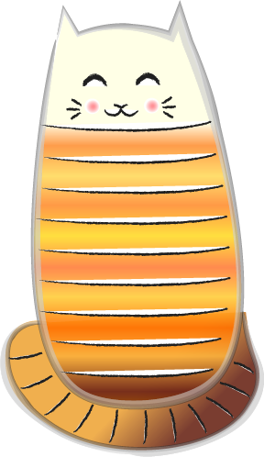
Screen Sketches
6 April 2020
Next
6 April 2020
Stressed
Take a Break !
10
Screen 1
Screen 2
10
1
Next
Kate Shan

Slide 7
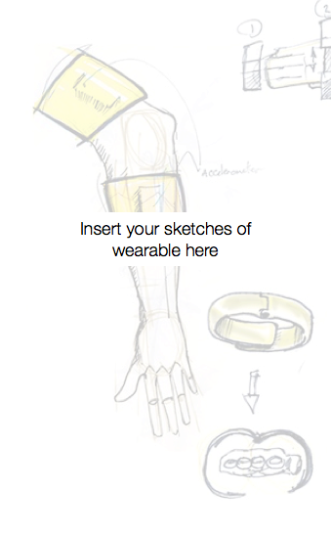
Paired Sketches
6 April 2020
6 April 2020
Stressed
Take a Break !
10
10
Screen 1
Screen 2
1
Next
Kate Shan

